Slide 1

Web application penetration testing tools and methodology
- AhmedFaseeh Akram, Haris Khan, Hunzalah Bhatti

Slide 2
82%
Ransomware complaints in the US increased by 82%, with a 449% rise in ransom payments between 2019 to 2021 [2].
The next five years are due to see a 15% increase in cybercrime costs reaching 10.5 trillion by 2025 [1].
15%
$9.05M
USA had the highest rate of costly data breaches in 2021 at $9.05 million according to IBM [3].

Slide 3
So how can companies prevent these attacks ??
They use penetration testing tools !!!

Slide 4
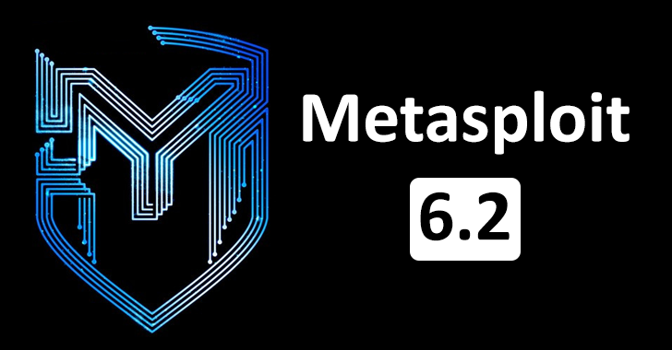





What is a Penetration Tool ???
Definition
Processes, tools, or services created and put into use with the intention of modeling attacks and data breaches and identifying security flaws are referred to as penetration testing, or pentesting.
The main goal of a pentest is to discover vulnerabilities that attackers can exploit.
Metasploit
Burpsuite
Wireshark
Nikito

Slide 5
How exactly is a pen-test carried out ?

Slide 6
Steps Of Pen-testing
Maintain Access
This phase looks for weaknesses in a target by using web application attacks like SQL injection, backdoors etc . to determine the harm that these vulnerabilities can cause
Scanning
Pentesters can use this to learn how the application reacts to different threats.
01
02
03
04
05
Planning
Defining a test's objectives and scope, as well as the systems to be tested and the testing techniques to be applied.
Obtaining intelligence (such as mail servers) to learn more about a target's operation and possible weaknesses.
Access Gain
This phase looks for weaknesses in a target by using web application attacks like SQL injection, backdoors etc . to determine the harm that these vulnerabilities can cause
Testers attempt to exploit them, usually by gaining more authority, stealing information, intercepting traffic, etc.
Analysis
Evaluate the penetration test's results by obtaining a report that lists all exploited vulnerabilities, sensitive data accessed, and the duration of the system's response to the pentester's intrusion.

Slide 7
The benefits of pentesting ?

Slide 8
Benefits of pen-testing
01
Find vulnerabilities in web applications' security
Check the effectiveness of the current security controls and policies.
02
Examine the strength and configuration of any publicly accessible components, such as firewalls.
03
It aids in assessing the security posture of the entire web application, including the database and back-end network, web app penetration testing is crucial. It also makes suggestions for how to make it stronger.

Slide 9
Example of a Pentesting Tool:
Burp Suite

Slide 10

Burp Suite
Stops the request being sent
Allows us to modify the request
Send the modified request
Burp, or Burp Suite is a collection of tools used to test web applications for vulnerabilities.
Burp Suite is best described as an Interception Proxy in its most basic form. A penetration tester can set up their web browser to route traffic through the Burp Suite proxy server while they are using their target application.
Burp Suite serves as a sort of Man in the Middle by intercepting and examining each request made to and from the target web application.

Slide 11








Tools In Burp Suite
Spider
Target a webpage
Find potential vulnerabilities
01
01
08
Proxy
Lets you modify content of requests mid transit.
02
Sequencer
Enables user to analyze the quality of randomness in a sample of tokens.
02
05
Intruder
Using this, a set of values is passed through an input point.
After running the values, the content length and success/failure of the output are noted.
07
03
Decoder
Decoder lists the common encoding methods like URL, HTML, Base64, Hex, etc.
The tools offered by Burp Suite
06
03
Extender
BurpSuite supports external components to be integrated into the tools suite to enhance its capabilities.
Repeater
Repeater lets a user send requests repeatedly with manual modifications
04
07
06
Scanner
The website is automatically scanned for numerous common vulnerabilities, and a list of them is produced.
04
08
05

Slide 12
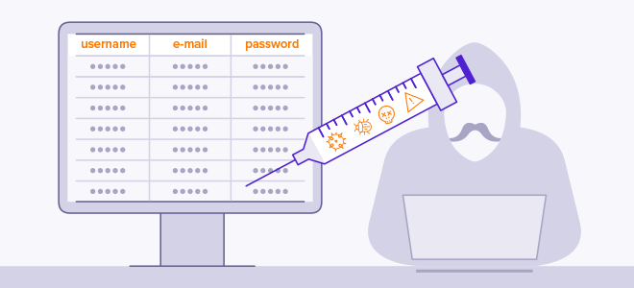
Attack Example: SQL Injection
What is SQLi
Code injection method that could wipe out your database.
One of the most popular methods for web hacking.
The act of inserting malicious code into SQL statements through web page input.
What is it
What it does
Attack type
An SQL injection attack is the process of inserting, or "injecting," a SQL query into the application through client input data.
If a SQL injection exploit is successful, it can read confidential data from databases, change data in databases (Insert, Update, Delete), perform database administration tasks (like stopping the DBMS), and more.
Predefined SQL commands are executed differently by injecting SQL commands into data-plane input.

Slide 13
Time for the demo !

Slide 14





For the demo, we used….

Slide 15

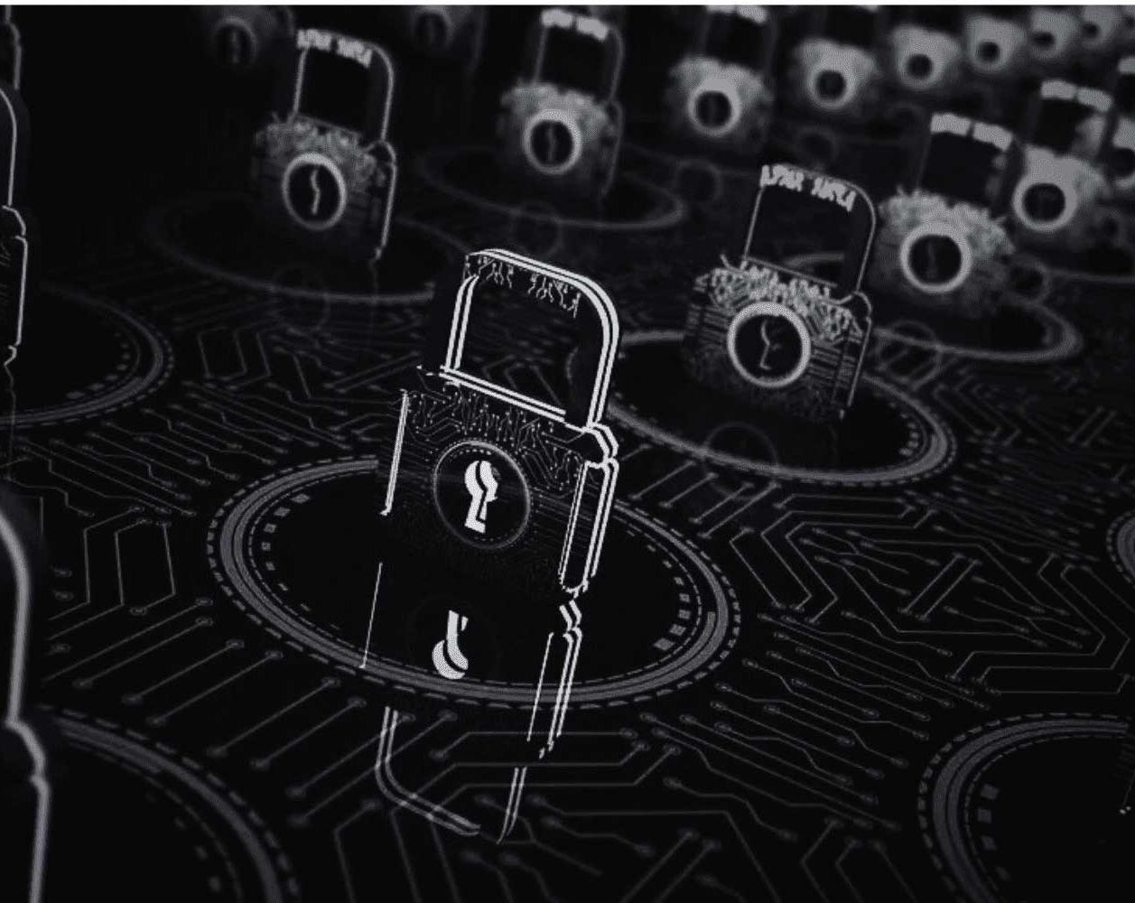
Vulnerabilities Identified
Authentication Bypass using cookie tokens
Maintaining Access Control by changing users’ passwords via SQL Injection
Sensitive Data exposure (credit cards, login and passwords)
Identity theft (addresses, names, mobile numbers)

Slide 16
WORKS CITED IN PRESENTATION
[1] “Cybercrime To Cost The World $10.5 Trillion Annually By 2025,” Cybercrime Magazine, Feb. 21, 2018. https://cybersecurityventures.com/hackerpocalypse-cybercrime-report-2016/#:~:text=Cybersecurity%20Ventures%20expects%20global%20cybercrime
[2] N. James, “Cyber Crime Statistics 2023: Cost, Industries, and Trends - Astra Security Blog,” www.getastra.com, Dec. 06, 2022. https://www.getastra.com/blog/security-audit/cyber-crime-statistics/
[3] First Response, “UK and US Cybercrime Statistics,” First Response, Jul. 12, 2022. https://first-response.co.uk/articles/uk-and-us-cybercrime-statistics/ (accessed Nov. 16, 2023).

Slide 17
THANK YOU

